Slide 1
Java assignment 2

Slide 2
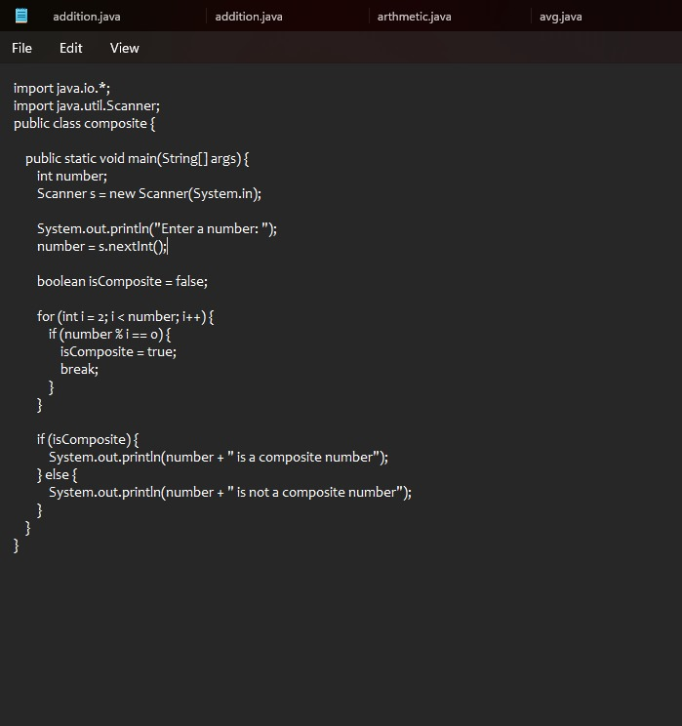
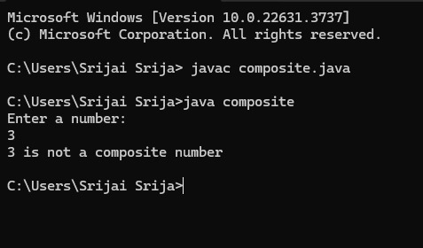
17. Write a program to print all the composite numbers between a and b?

Slide 3
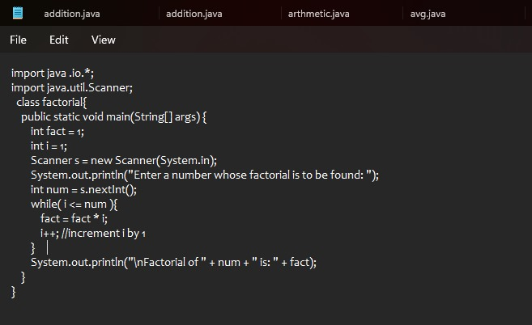
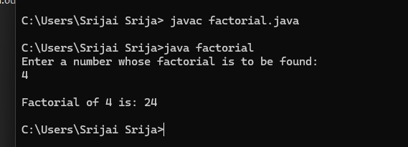
20. Find the factorial of n using while loopSample Input:N = 4Sample Output:4 Factorial = 24

Slide 4
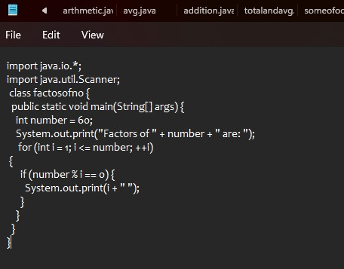
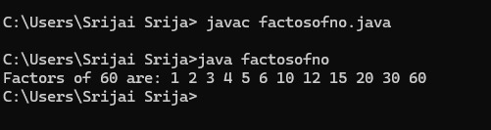
23. Find the number of factors for the given numberSample Input:Given number: 100Sample Output:Number of factors = 9

